Slide 1
Malignant Comment Classifier
By Junaid Shaikh

Slide 2
Problem Statement
The proliferation of social media enables people to express their opinions widely online. However, at the same time, this has resulted in the emergence of conflict and hate, making online environments uninviting for users. Although researchers have found that hate is a problem across multiple platforms, there is a lack of models for online hate detection.
Online hate, described as abusive language, aggression, cyberbullying, hatefulness and many others has been identified as a major threat on online social media platforms. Social media platforms are the most prominent grounds for such toxic behaviour.
There has been a remarkable increase in the cases of cyberbullying and trolls on various social media platforms. Many celebrities and influences are facing backlashes from people and have to come across hateful and offensive comments. This can take a toll on anyone and affect them mentally leading to depression, mental illness, self-hatred and suicidal thoughts.
Internet comments are bastions of hatred and vitriol. While online anonymity has provided a new outlet for aggression and hate speech, machine learning can be used to fight it. The problem we sought to solve was the tagging of internet comments that are aggressive towards other users. This means that insults to third parties such as celebrities will be tagged as unoffensive, but “u are an idiot” is clearly offensive.

Slide 3
Business Goal
Our goal is to build a prototype of an online hate and abuse comment classifier which can be used to classify hate and offensive comments so that it can be controlled and restricted from spreading hatred and cyberbullying.

Slide 4
About Dataset
The data is split into two parts, train and test. The train set has 159571 rows and 8 columns, while the test set has 153164 rows with 2 columns. Hence, there were 6 target variables, i.e., 6 different categories, these were, malignant, highly_malignant, rude, threat, abuse, loathe.
There were no null or missing values present in the datasets.

Slide 5
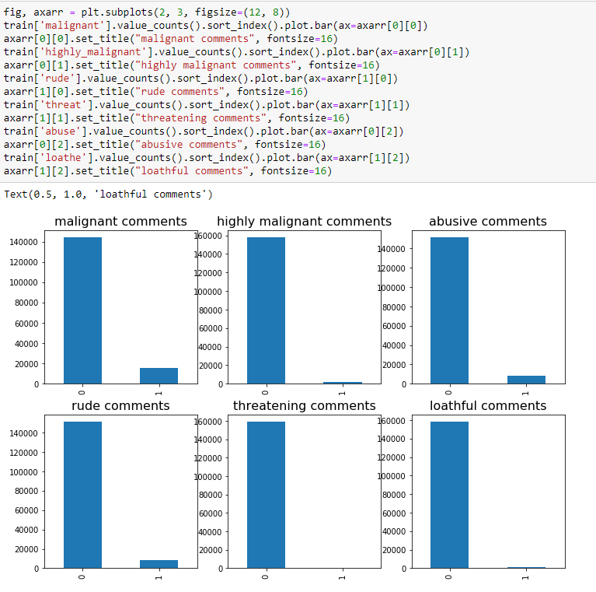
EDA
This is the subplot to study the data distribution.
As we can see clearly, the data is highly imbalanced.

Slide 6
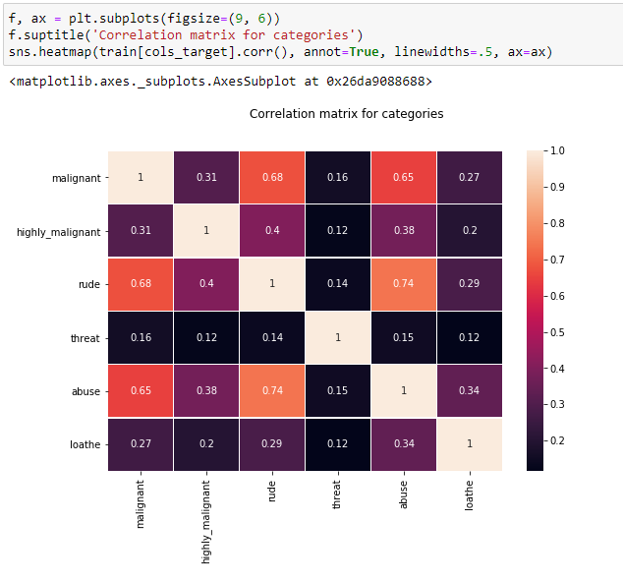
EDA
This is the heatmap for all of the target variables only.
We can notice that rude and abuse have the highest correlation around 0.74, while the threat column had least correlation with other columns with values ranging between 0.12 - 0.16.

Slide 7
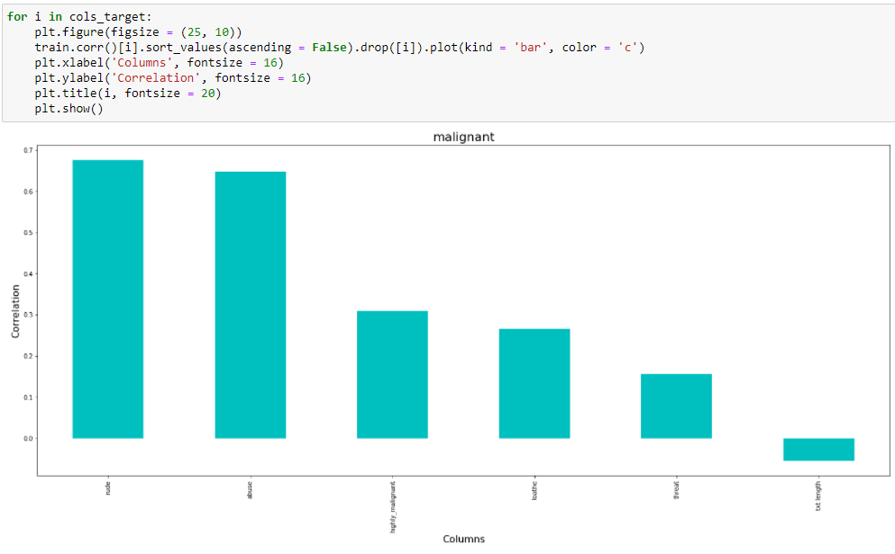
EDA

Slide 8
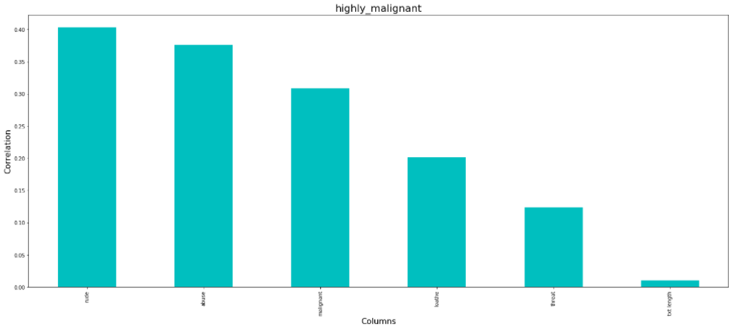
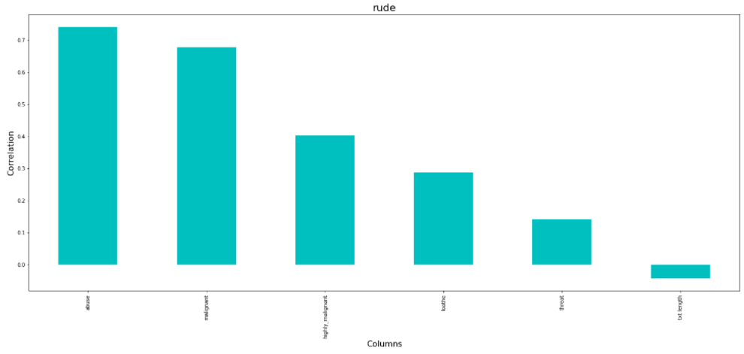
EDA

Slide 9
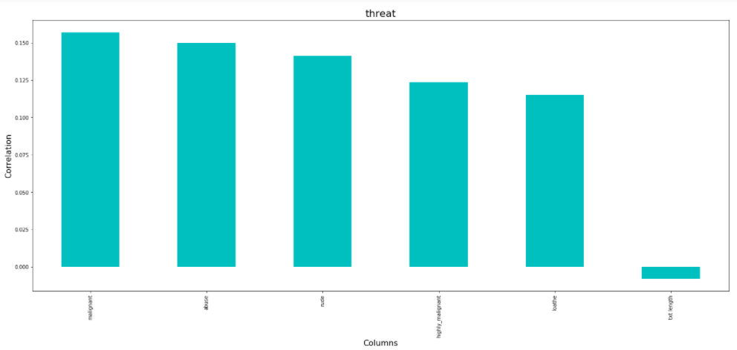
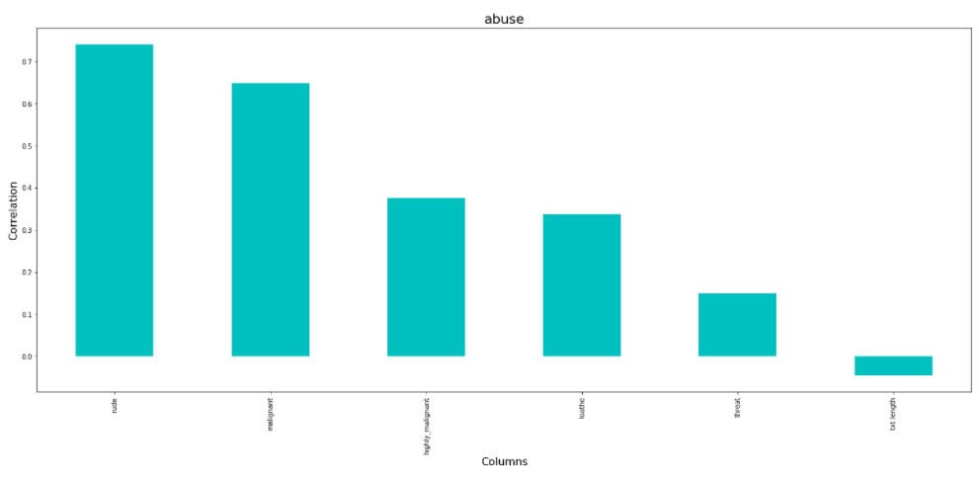
EDA

Slide 10
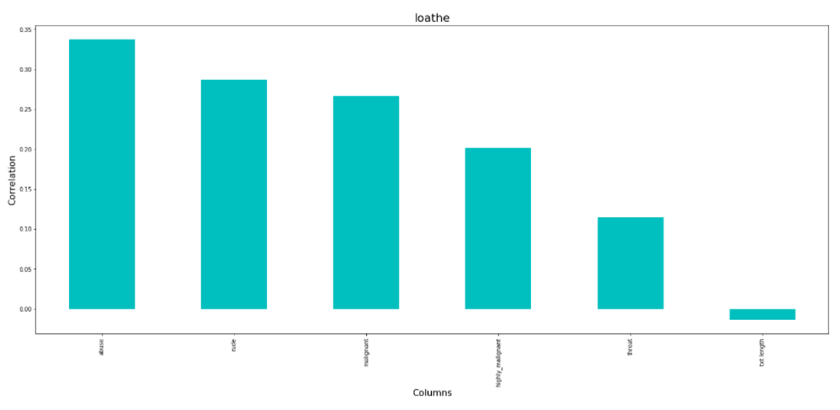
EDA

Slide 11
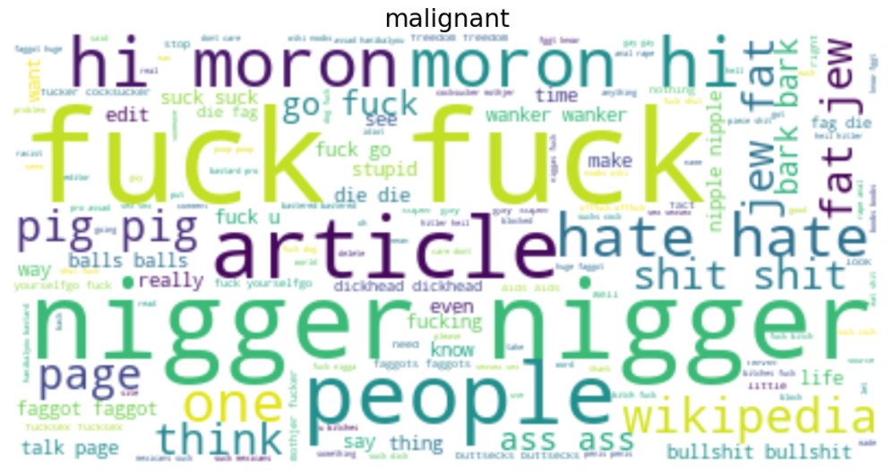
Word Cloud for Malignant
This is the word cloud for malignant comments.
As we can see, the content of the word cloud are pretty offensive and we can observe some racist words used in this.

Slide 12
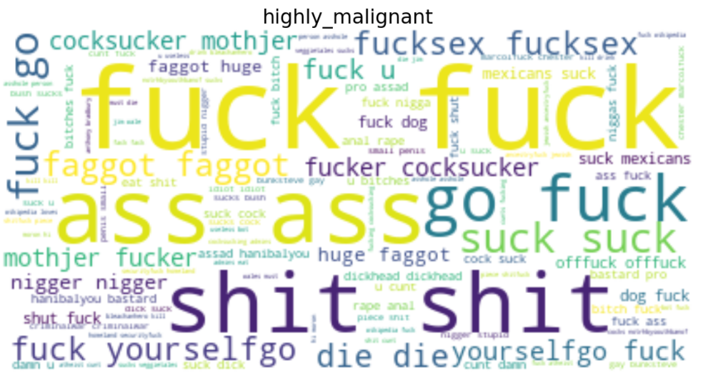
Word Cloud for Highly Malignant
This is the word cloud for highly malignant comments.
As we can see, the content of the word cloud are pretty offensive and we can observe words like ‘Fuck’, ‘Shit’, etc very commonly used.

Slide 13
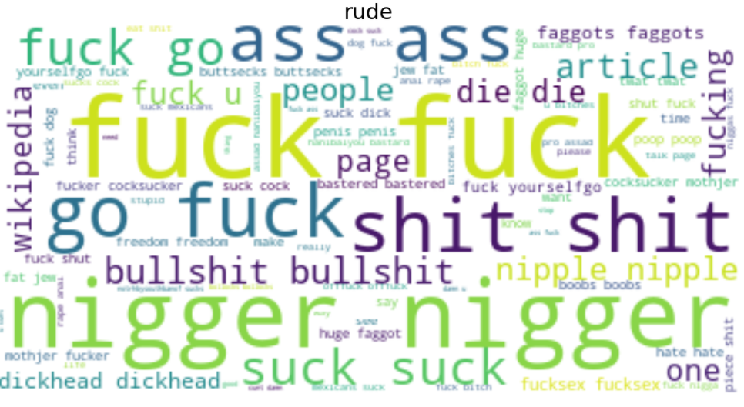
Word Cloud for Rude
This is the word cloud for rude comments.
As we can see, the content of the word cloud are pretty offensive and we can observe some racist and homophobic words used in this.

Slide 14
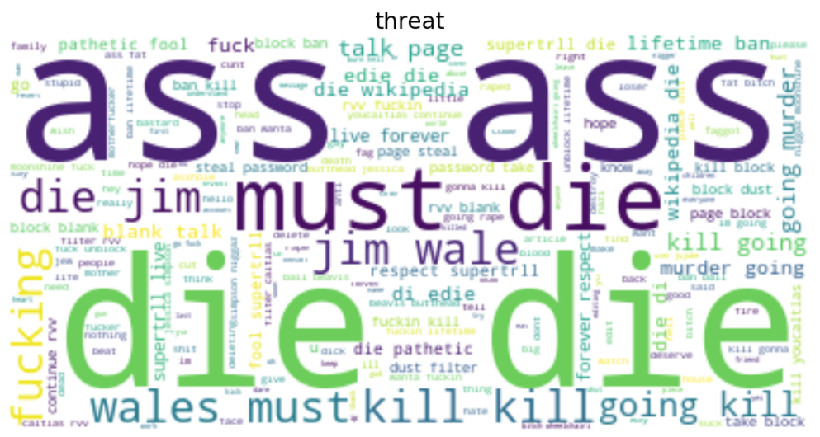
Word Cloud for threat
This is the word cloud for threatening comments.
As we can see, the content of the word cloud are pretty offensive and we can observe some threat words like ‘die’, ‘kill’, ‘murder’, etc, used in this.

Slide 15
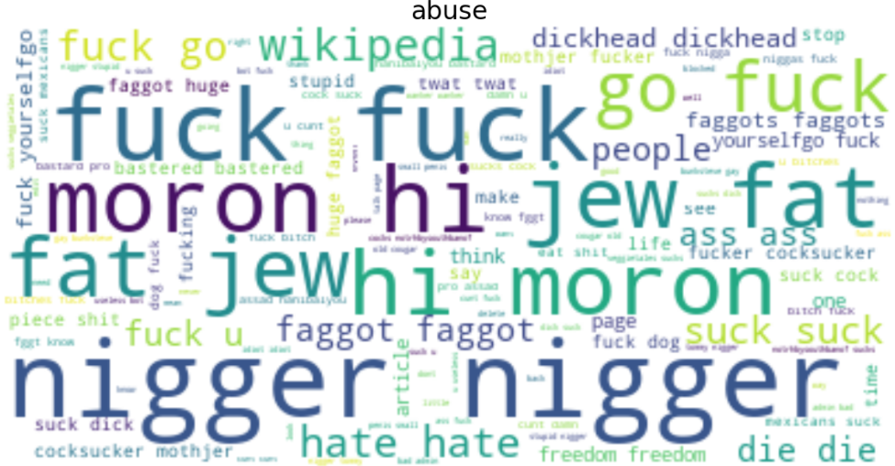
Word Cloud for abuse
This is the word cloud for abusive comments.
As we can see, the content of the word cloud are pretty offensive and we can observe some racist and body shaming words used in this.

Slide 16
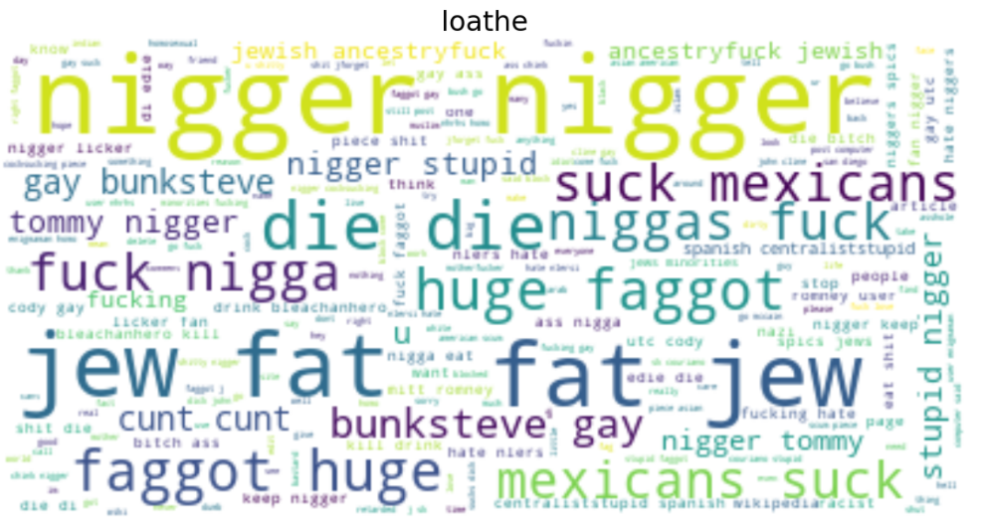
Word Cloud for loathe
This is the word cloud for loathe comments.
As we can see, the content of the word cloud are pretty offensive and we can observe racist and homophobic words used very frequently in this.

Slide 17
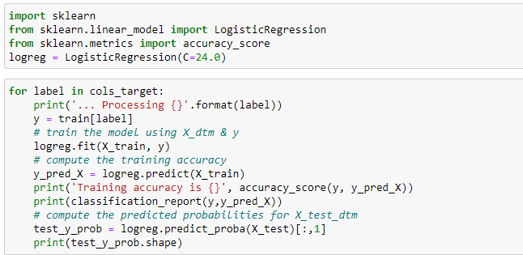
Model Building - Logistic Regression
After preprocessing the data and building our model on the dataset, our accuracy scores were Logistic Regression - 0.964, 0.9924, 0.9841, 0.9984, 0.9761, 0.9945 for malignant, highly_malignant, rude, threat, abuse, loathe respectively.

Slide 18
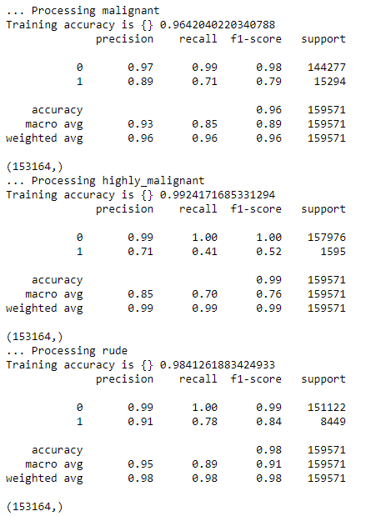
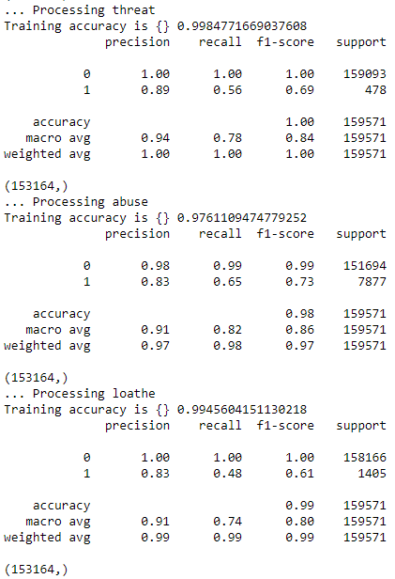
Continue...

Slide 19
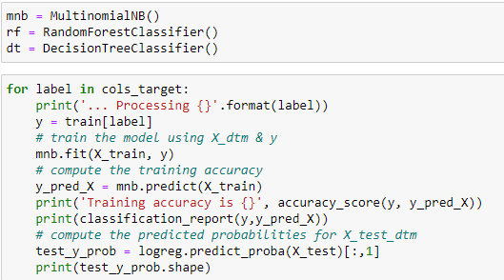
Model Building - Logistic Regression
After preprocessing the data and building our model on the dataset, our accuracy scores were MultinomialNB- 0.9519, 0.9908, 0.9749, 0.9970, 0.9700, 0.9918 for malignant, highly_malignant, rude, threat, abuse, loathe respectively.

Slide 20
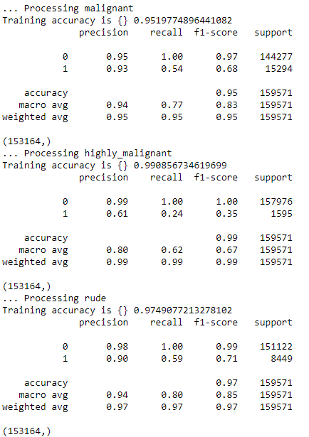
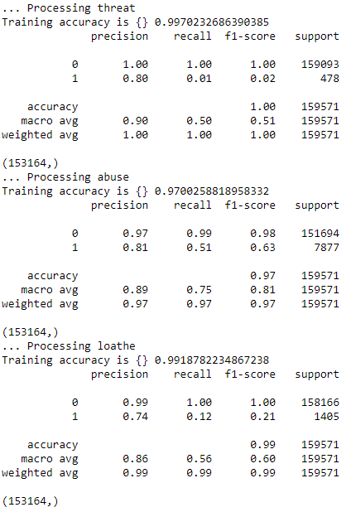
Continue...

Slide 21
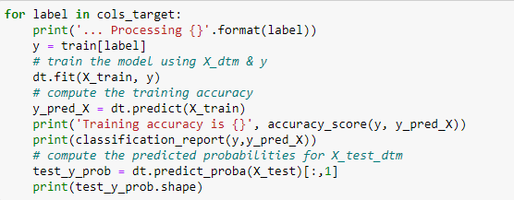
Decision Tree Classifier
After preprocessing the data and building our model on the dataset, our accuracy scores were Decision Tree Classifier - 0.9974, 0.9989, 0.9985, 0.9998, 0.9977, 0.9994 for malignant, highly_malignant, rude, threat, abuse, loathe respectively.

Slide 22
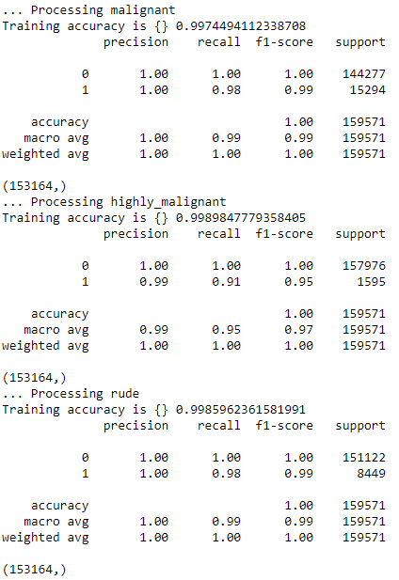
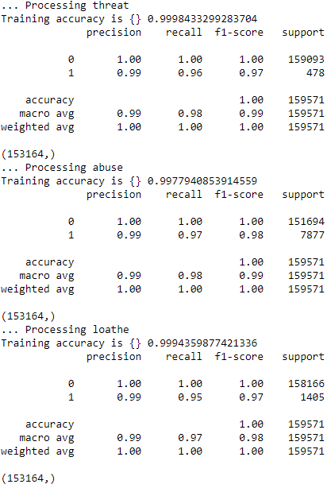
Continue...

Slide 23
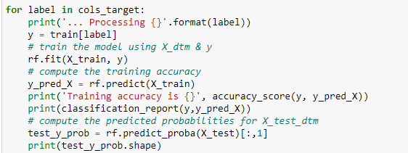
Random Forest Regressor
After preprocessing the data and building our model on the dataset, our accuracy scores were Random Forest Classifier - 0.9974, 0.9989, 0.9985, 0.9998, 0.9977, 0.9994 for malignant, highly_malignant, rude, threat, abuse, loathe respectively.

Slide 24
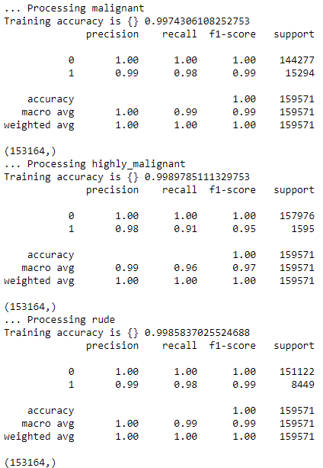
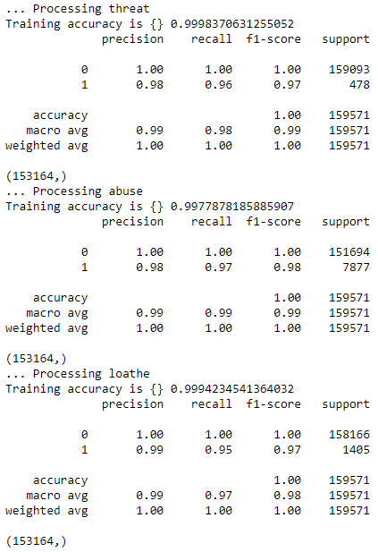
Continue...

Slide 25
Model Selection
Our decision tree model and random forest model had same accuracy upto 4 decimal digits but decision tree model had slightly better precision and recalls, hence we decided to finalize our Decision Tree model.

Slide 26
Conclusion
In this project, we studied how people behave on different social media platforms where they had no jurisdiction to govern their antics .
Using predictive modeling and EDA we can determine which comments can be labelled as toxic or malignant and the severity of the comment by just processing the contents of the content.
After all the data processing and data analysis, we manage to build a model which will give us fairly accurate results.

